Slide 1
A fully coupled implementation of hydrogen embrittlement in FE analysis
Daniel Huang
Department of Mechanical Engineering
Aalto University

Slide 2
The paper provides a guideline and codes through a practical case:
A cohesive zone model simulates the fracture toughness test of a C(T) specimen charged with hydrogen. The model in the fully coupled formulation is enriched with a sensitivity analysis to prove the capability under different conditions.
Target: Fully coupled vs Weakly coupled & Theoretical Explanation

Slide 3
Contnets
Background
Scope
Theoretical Explanation
Assumptions
Comparison
Conclusion

Slide 4
THEORETICAL BACKGROUND
Hydrogen Embrittlement Mechanics
Hydrogen-Enhanced Localized Plasticity (HELP)
Hydrogen-Enhanced Decohesion (HEDE)
Hydrogen-Induced Phase Transformations
Hydrogen-Enhanced Strain-Induced Vacancies
Hydrogen Trapping
Hydrogen-vacancy interactions
Adsorption-Induced Dislocation Emission
Hydride formation
Hydrogen Embrittlement Theories
Hydrogen reaction embrittlement
Internal reversible hydrogen embrittlement
Hydrogen environmental embrittlement
Different Approach
Atomistic simulation (Analysis Method)
Influence of Stacking Fault Energy
Peridynamic Hydrogen Embrittlement Model (Analysis Method)
Local Stress Criterion
Phase Field-Based Models (Analysis Method)
Combined Effect of Hydrogen Embrittlement and Loss of Constraint

Slide 5
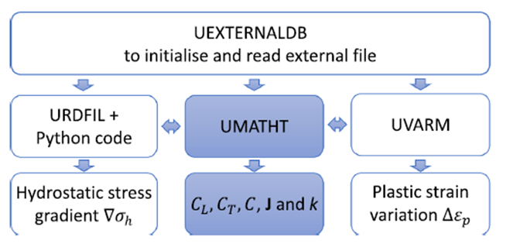
BACKGROUND CONDITION
AISI 4130 steel
A HEDE mechanism is simulated scaling the TSL
Heat transfer replace mass diffusion
Macro level discussion
Replace Fourier law with user defined function

Slide 6
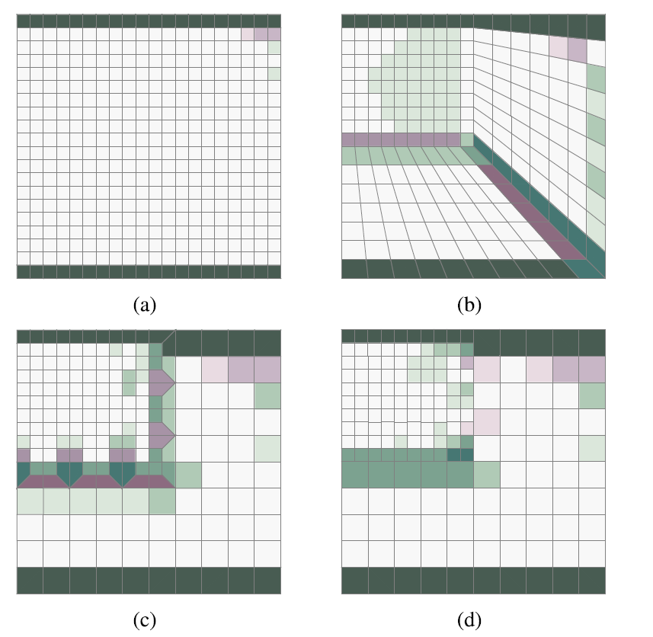
SCOPE
Weakly Coupled
Fully Coupled
FEM Mesh
Static Analysis
Diffusion Analysis
Static Analysis
UMATHT
Material property and stress
Crack Propagation
Hydrogen diffusion

Slide 7




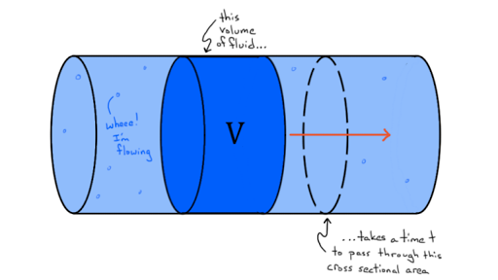
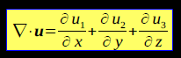

THEORETICAL EXPLANATION
BASIC RELATION
Continuity Equation (Hydrogen Diffusion)
Continuity Equation (Heat Transfer)
H number unit V
Internal thermal energy per unit mass
Heat Source
Density
H flux
$$r_{q}=0, ρ=1$$
Heat Flux

Slide 8
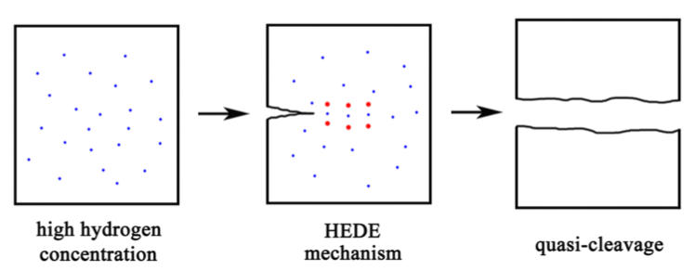




THEORETICAL EXPLANATION
CONCENTRATION AND FLUX
H concentration
Diffusible H
Trapped H
Hydrogen Flux
Partial Molar Volume
Flux With
Diffusible H
Diffusible H Gradient
Hydrostatic Stress Gradient
Effective Diffusivity
Universal Gas Constant & Temperature
Fick’s First Law
Ideal Gas Law
$$J=−D\frac{dc}{dx}$$
Mole number
Internal condition
Flux
$J_{m}=−D_{L}∇C_{L}+{n\frac{{∇σ_{H}V}_{H}}{P V}D}_{L}C_{L}=D_{L}$(- $∇C_{L}$+ $\frac{{∇σ_{H}V}_{H}}{P \frac{n}{V}} C_{L}$)
Gradient of Diffusible H
Gradient of Hydrostatic
External condition

Slide 9
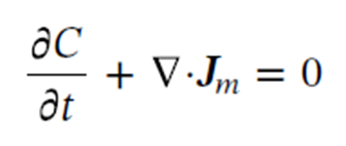

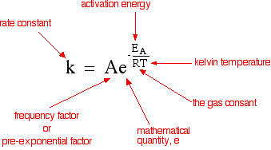

THEORETICAL EXPLANATION
TRAPPED CONCENTRATION
Continuity Equation (Hydrogen Diffusion)
Hydrogen Flux
H concentration
Diffusible H
Oriani’s theory for trapped H
Trap site density
Trapped H
Arrhenius Equation
Equilibrium constant
Interstitial lattice sites density
Binding enthalpy ΔWB=-60kJ/mol

Slide 10


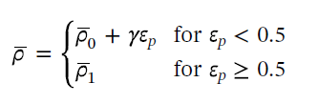

THEORETICAL EXPLANATION
CONCENTRATION SITE DENSITIES
Avogadro Constant=
6.02214076×10 ^23 /mole
Number of interstitial =6
Interstitial density for α-Fe
Iron Density=7.87×103 kg/m3 at 293 K
Molar mass = 55.8×10-3 kg/mol3 at 293 K
Oriani’s theory for trapped H
Experimental (Kumnick and Johnson)
Plastic strain
Sofronis method
2 × 10^16m/m^3
Trap site density
1 × 10^10 m/m^3 (Annealed)
Dislocation density
Notes:
Sofronis method compared McNabb-Foster (CT not direct to CL) and Oriani's theories
Lattice parameter= 2.86 × 10^10m (BCC iron)
1 × 10 ^16 m/m^3 (Max)

Slide 11
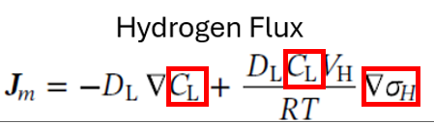
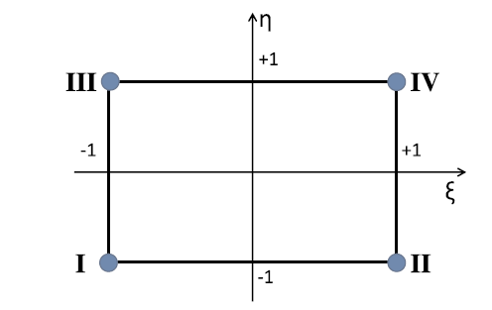
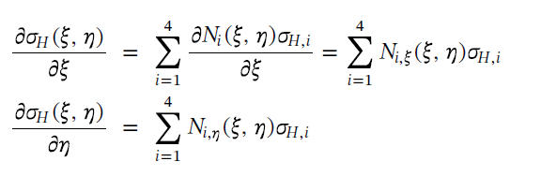
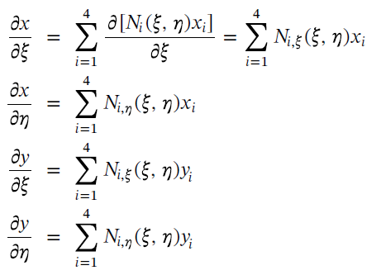
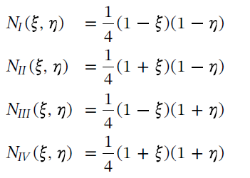

THEORETICAL EXPLANATION
FLUX HYDROSTATIC STRESS
Hydrostatic Stress Gradient
Averaging extrapolated nodal stress
Stress field from interpolated nodal stresses and shape function
Element and nodal shape functions
Hydrostatic stress relates to coordinate
Coordinate Conversion
Jacobian Matrix

Slide 12
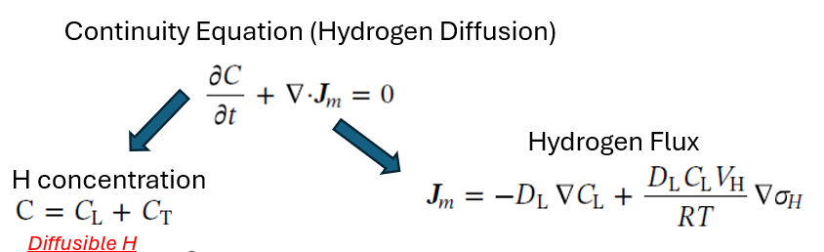
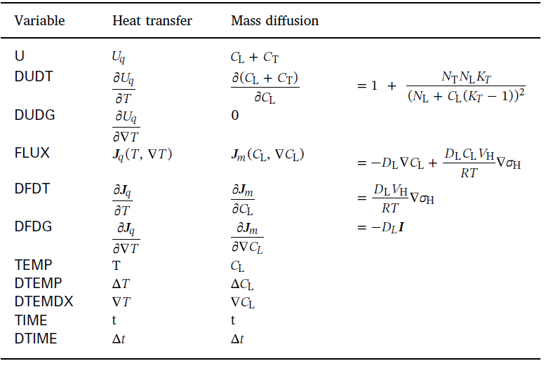

THEORETICAL EXPLANATION
FINAL VARIABLE
The basic Abaqus thermal model refers to the Fourier law, which can’t implement the complex relations defined earlier. Therefore, UMATHT subroutine was used.

Slide 13

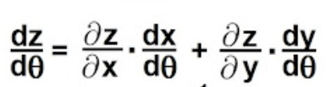

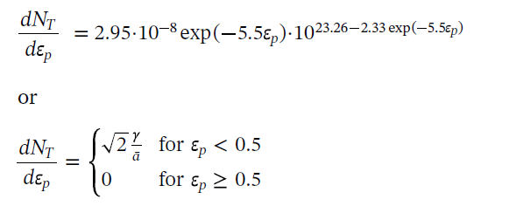

THEORETICAL EXPLANATION
CONCENTRATION INCREMENT
H concentration
H concentration increment (Fully coupled)
Chain rule with partial derivatives
Concentration at time t
Concentration difference according to diffusible H
Concentration difference according to trapped H (Plastic Strain)
Experimental (Kumnick and Johnson)
Sofronis method

Slide 14
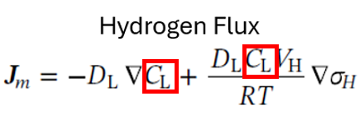


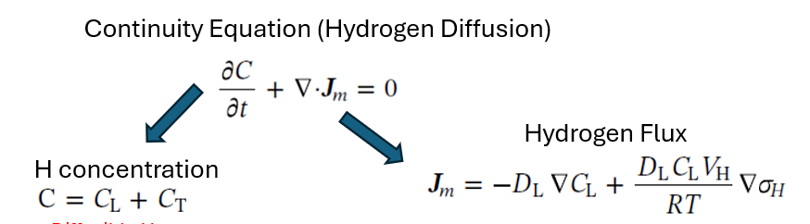
THEORETICAL EXPLANATION
PARAMETERS AND CONNECTIONS
identity tensor

Slide 15
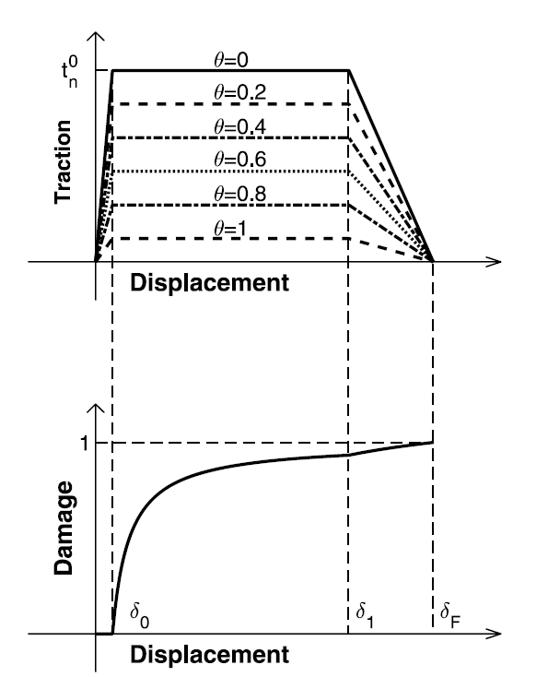


THEORETICAL EXPLANATION
TSL AND CONCENTRATION
Hydrogen coverage factor
Traction Separation Law
(Selected trapezoidal shape with four parameters)
Hydrogen concentration
Variation of Gibbs free energy=30kJ/mol
Factor decreasing cohesive strength (HEDE mechanism)
Limit stress of the cohesive element (Pa)

Slide 16
Density (Continuity equation) equals to 1
Binding Enthalpy (Activation energy) equals to -60kJ/mole and A=1(Arrhenius equation )
Sofronis Method Assumptions
Extrapolation data for the hydrostatic stress calculation
Initial concentration is 1.5 ppm and uniformly distributed on the samples
Interstitial Density values
TSL shape and parameter selection
Gibs free energy as 30kJ/mol
ASSUMPTION AND SELECTIONS

Slide 17
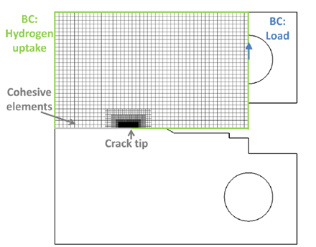
FEM SETTING
Symmetric model
Linear quadrilateral elements with plane strain formulation
Mesh is progressively refined, up to 15.6 μm to the symmetric plane
Mesh of cohesive elements with rectangular shape (0.53 mm high and 1.53 mm long, ahead of the crack tip) are approach around crack tips
TSL parameters with Relaxed ratios between the separations δi for calibration

Slide 18
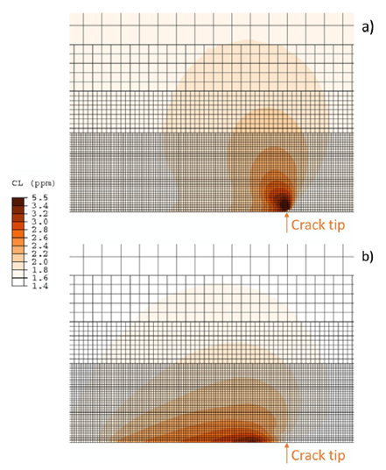
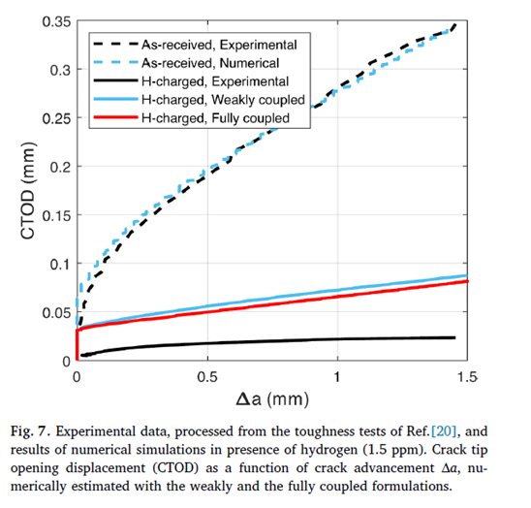
COMPARISON
Hydrostatic stress
Hydrostatic stress
gradient

Slide 19
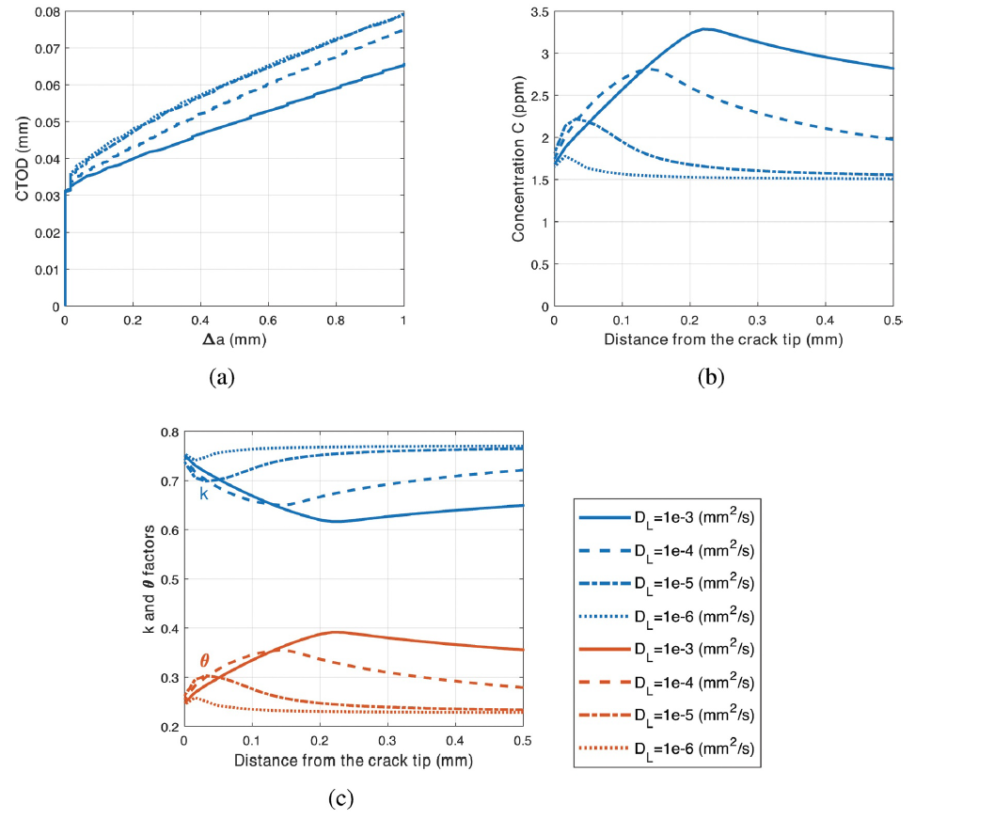
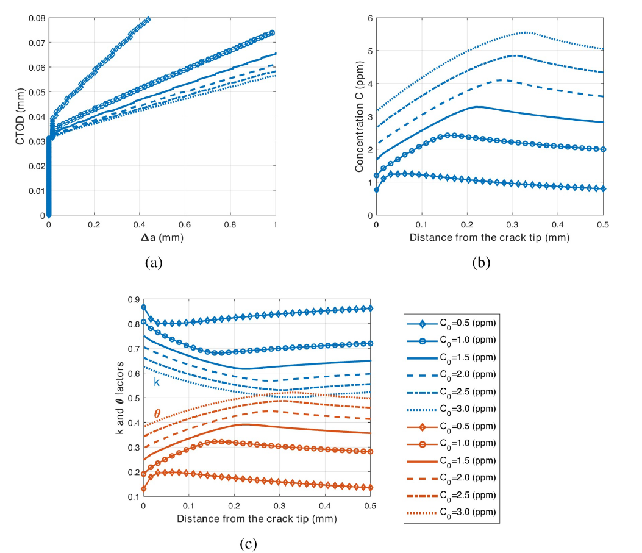
SENSITIVITY
DL between 1*10^-3 to 1*10^-6 mm^2/s
C0 between 0.5 and 3 ppm
Selection of DL and C0 according to the case condition

Slide 20
CONCLUSION
Possible of many mechanism acting at the same time but not only HEDE
Subroutine UMATHT is called when the time increment is not yet converged, so that actually the present implementation uses Δεp estimated at the preceding converged increment. However, for small Δt the associated error is considered negligible.

Slide 21

NEXT STEP
Primary:
Compare and analysis more closely our fully coupled model with presented one
Secondary:
More learning on Abaqus
Ultimate Goal
Improving the model and apply in Abaqus or Mathematica

Slide 22
Thank you!

